Slide 1






FINAL PROJECT – AI4E
Predicting
Life Expectancy

Slide 2
Content of the presentation
1
2
3
STEP
STEP
STEP
Dataset Overview
Exploratory Data Analysis
Train data and Conclude
Understanding data structure, missing values, types.
Analyzing relationships, visualizing patterns, summarizing statistics.
Model training, evaluating, and drawing conclusions.

Slide 3



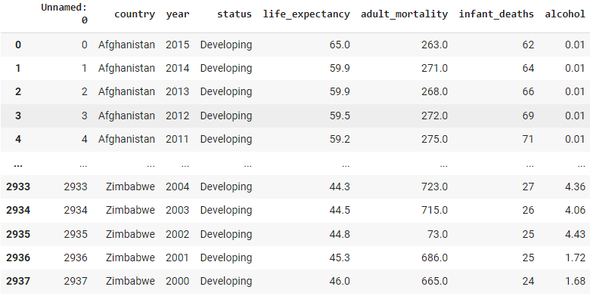
Dataset Overview
I use the Life Expectancy (WHO) Kaggle dataset for this demonstration.
Keeps track of the health status as well as many other related factors for 193 countries Data from year 2000-2015 2938 rows x 23 columns Each row consists of multiple indicators for one country in a specific year. Link dataset: https://www.kaggle.com/datasets/kumarajarshi/life-expectancy-who
.

Slide 4
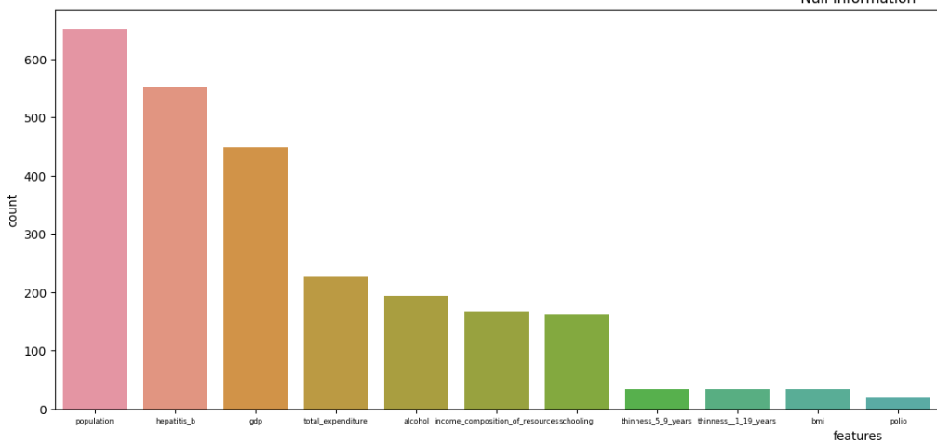
Exploratory Data Analysis
Null
Information
Check for missing data fields.

Slide 5
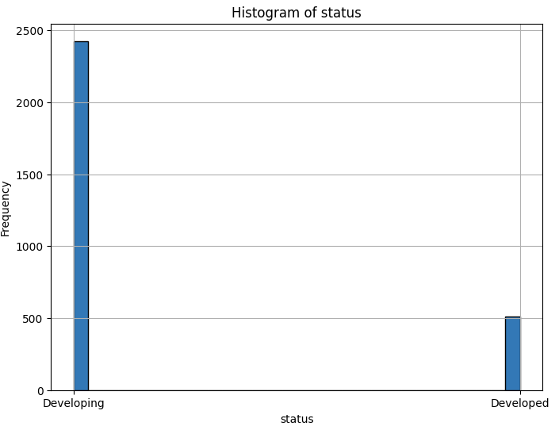
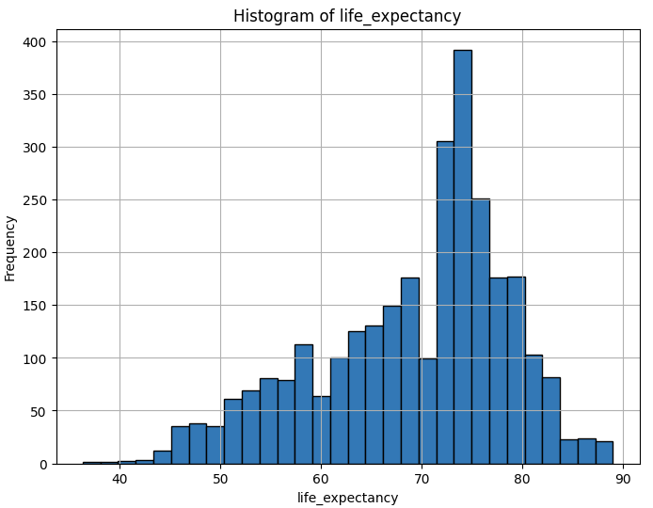
Exploratory Data Analysis
Histogram of
features

Slide 6
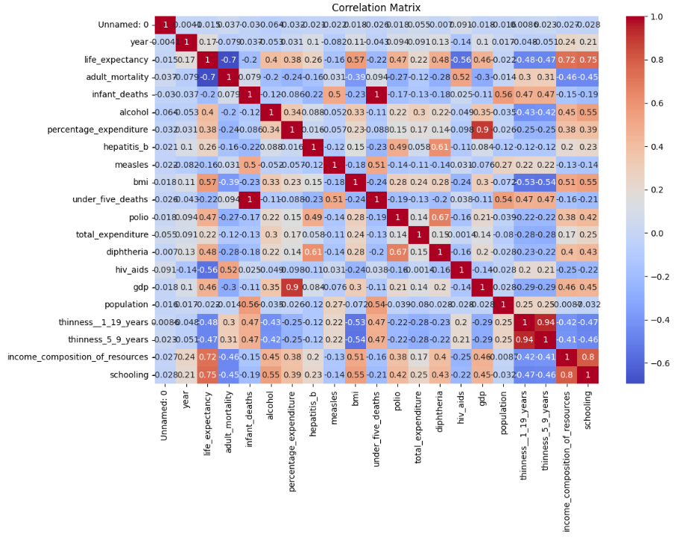
Exploratory Data Analysis
Correlation
Matrix
The Correlation Matrix signifies the relationship between variables in a dataset. It shows how each pair of variables is related, ranging from -1 to 1, indicating negative, positive, or no correlation between them.

Slide 7

Training Data
Data Preprocessing
Fill missing (NaN) values in data with the mean of each numerical column.
Encoding data features.
Split the data into training and testing sets.
Model for training
Linear Regression | Support Vector Regression | Random Forest | Gradient Boosting
Predicts values based on linear relationships. | Uses SVM for continuous value prediction. | Ensemble method using multiple decision trees. | Sequentially improves model accuracy.

Slide 8
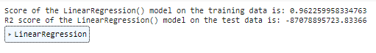
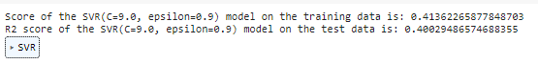
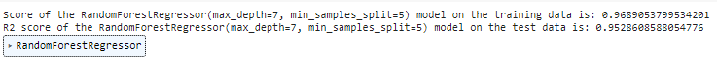
Linear Regression Model:
A negative R2 score indicates poor performance, suggesting the model is not fitting the test data and might have overfitting.
Support Vector Regressor (SVR):
The model shows relatively low scores in both training and testing data, indicating inefficiency.
Random Forest Regressor:
The model exhibits good scores in both training and testing data, with minor variance, suggesting it works well and is not overfitting.
Gradient Boosting Regressor:
The model showcases very high scores in both training and testing data, with minimal deviation, indicating efficiency and no overfitting.
Results and
Conclude

Slide 9






Thank you for listening.

